Slide 1
Clustering and Classification on Music Dataset
By:
Shrinidhi KR

Slide 2
Million Songs Dataset - Music Dataset
The dataset consists of features of a song like its loudness, tempo, key, mode, time-signature, which can be used to classify and cluster them accordingly.
The dataset used here is just a small sample subset of the huge dataset ( consisting of million records, over 300GB of open source data generated by "The Echo Nest" web based service ).

Slide 3
K - Means Clustering
K Means Clustering is an unsupervised learning algorithm that tries to cluster data based on their similarity. Unsupervised learning means that there is no outcome to be predicted, and the algorithm just tries to find patterns in the data.
In k means clustering, we have to specify the number of clusters we want the data to be grouped into. The algorithm randomly assigns each observation to a cluster, and finds the centroid of each cluster.
Then, the algorithm iterates through two steps:
Reassign data points to the cluster whose centroid is closest.
Calculate new centroid of each cluster.
These two steps are repeated till the within cluster variation cannot be reduced any further. Within the cluster variation is calculated as the sum of the euclidean distance between the data points and their respective cluster centroids.

Slide 4
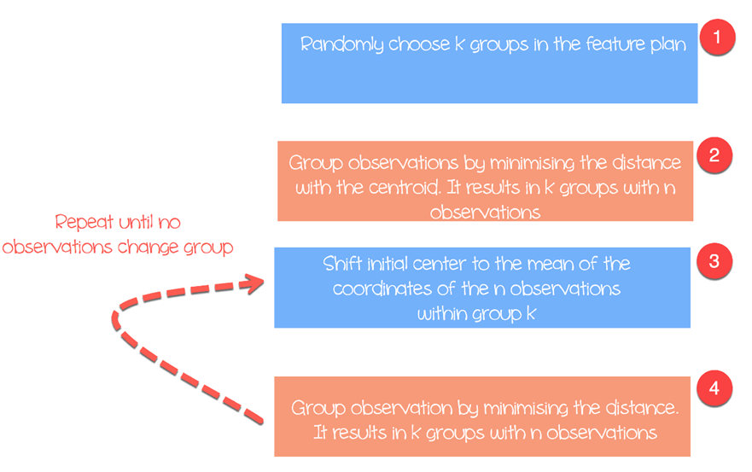
K - Means Algorithm

Slide 5
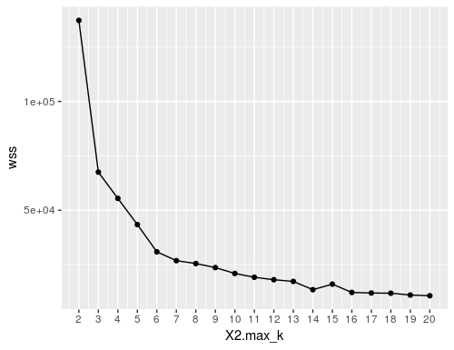
Finding Optimal K value using Elbow Method In the below plot it is clear that after k = 6 the decrease in within sum of squared value which specifies the variation in a cluster. This method uses within-group homogeneity or within-group heterogeneity to evaluate the variability. In other words, you are interested in the percentage of the variance explained by each cluster.

Slide 6
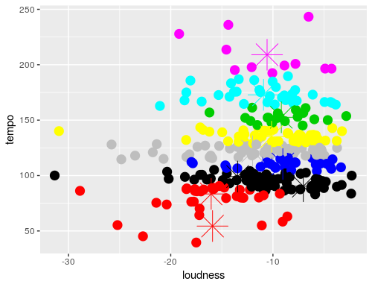
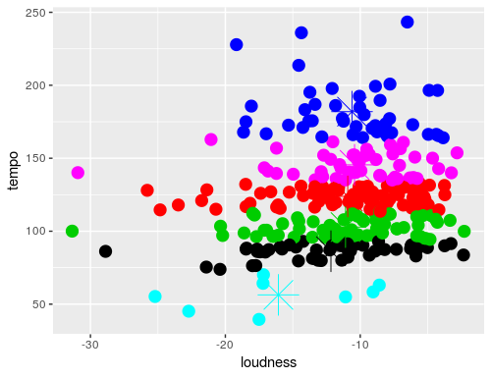
Plot 2 (After finding optimal K value)
Plot 1 (Taking K value as no. of genre)

Slide 7
K Nearest Neighbour
Classification (generalization) using an instance-based classifier can be a simple matter of locating the nearest neighbour in instance space and labelling the unknown instance with the same class label as that of the located (known) neighbour. This approach is often referred to as a nearest neighbour classifier.
In this algorithm, we will given some data points for training and also a new un-labelled data for testing. Our aim is to find the class label for the new point. Let x be the point to be labeled . Find the point closest to x . Let it be y. Now nearest neighbor rule asks to assign the label of y to x.
The K value specifies how many such closest point to x are to be considered before assigning the label to x, which same as the label of the compared points In k-NN classification, the output is a class membership. An object is classified by a majority vote of its neighbors, with the object being assigned to the class most common among its k nearest neighbors.If k = 1, then the object is simply assigned to the class of that single nearest neighbor.

Slide 8
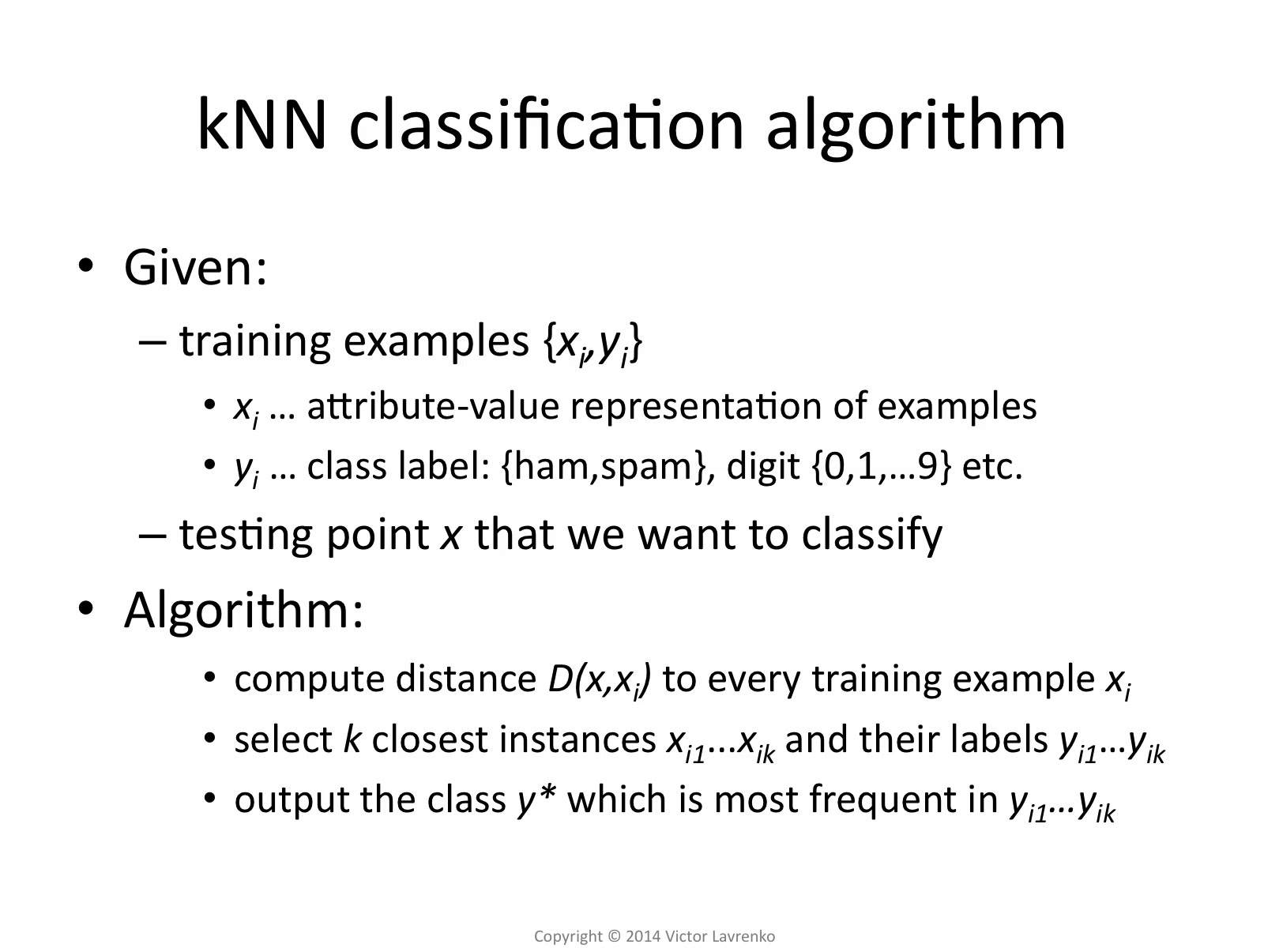

Slide 9
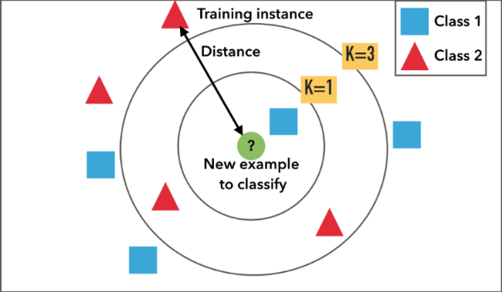
KNN Classifier

Slide 10
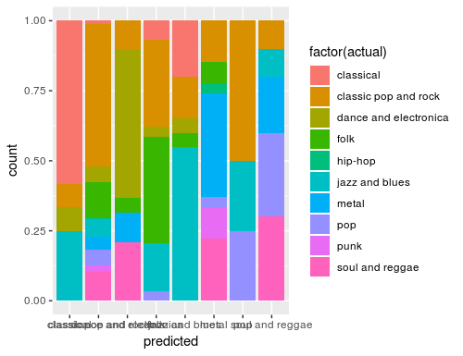
Plot 3 (K-NN classifier predicted Vs Actual genre)

